Slide 1
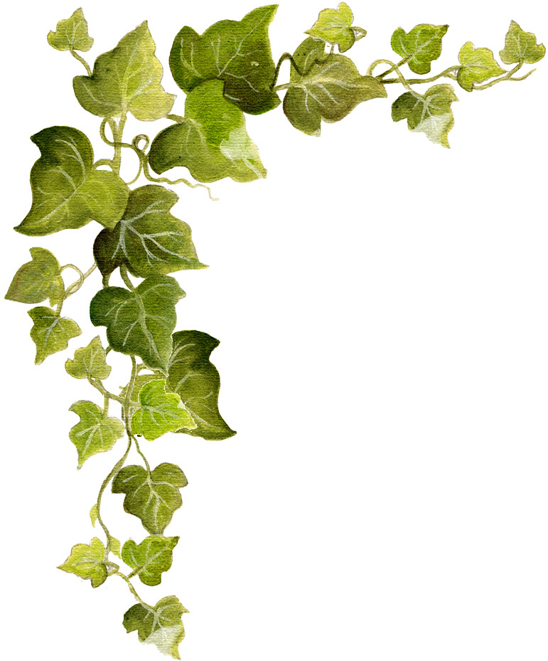
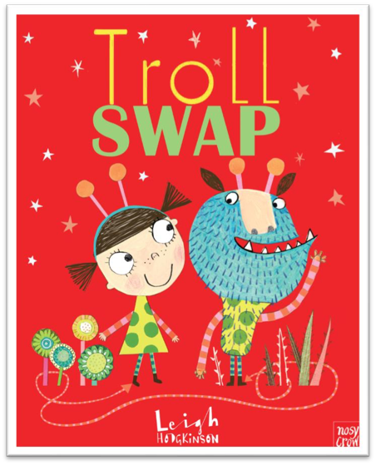



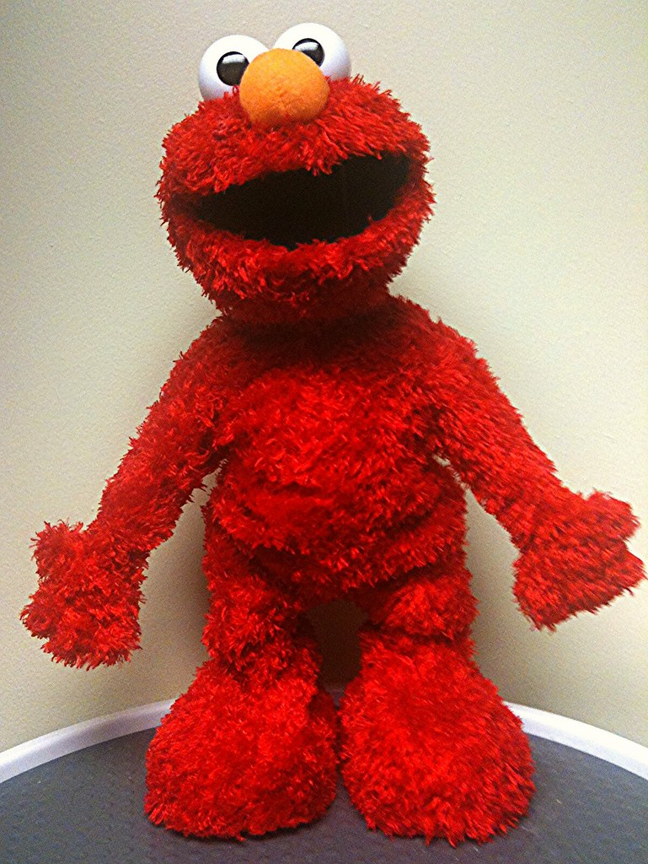
Year 2 Autumn Term
‘All About Me and Other Creatures!’
'Celebrations’
Welcome to Year 2!
English 1
Reading
Has a troll ever visited your home? Well, we suspect there may be one lurking in Year 2 or maybe its another type of creature- who knows?
This half term the children will be exploring narrative style texts written by Julia Donaldson. In addition, we will start to look at different text genres and their features. We will also continue with a daily phonics lesson.
Writing
Letter formation will be on the top of our list, including writing capital letters and simple sentences. Furthermore, we will be exploring nouns, verbs and the past and present tense.
Spelling
We will be enjoying learning new spelling rules to help us make important choices about how to spell new words and playing lots of games to become more familiar with the new Year 2 common exception words lists.
We are so excited to welcome you to the Autumn term and looking forward to all the new learning we have planned for our class.
Your Year 2 team are Mrs Ascroft, Mrs Felstead and a special class cuddly!
This half term is going to be all about consolidating and beginning to build on learning from Year 1.
Reading Books
These will be changed every Monday.
Please ensure your child has their reading book in school every day so that we can read their current book with them.
Homework
This will be sent on a Friday to be returned by the following Friday Spellings will also be sent for a spelling activity on the following Friday.
Please remember if you have any questions, we can be contacted via the school office or our class email -
yeartwo@croston-pri.lancs.sch.uk. We will also always be available on the school door in a morning and after school.
Science
In Science we will be using our 5 senses to investigate and exploring life cycles of animals, the importance of good hygiene and a balanced diet.
In the second half term we will be exploring materials and their properties.

Slide 2
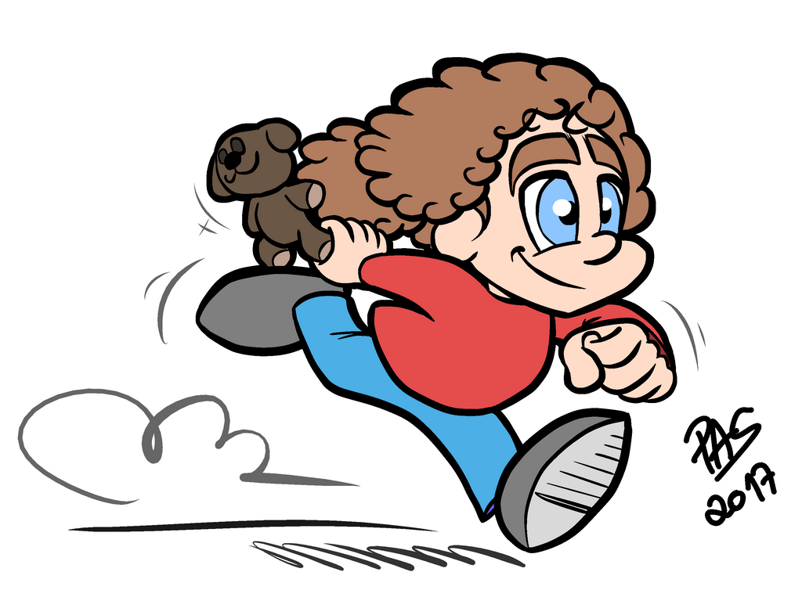

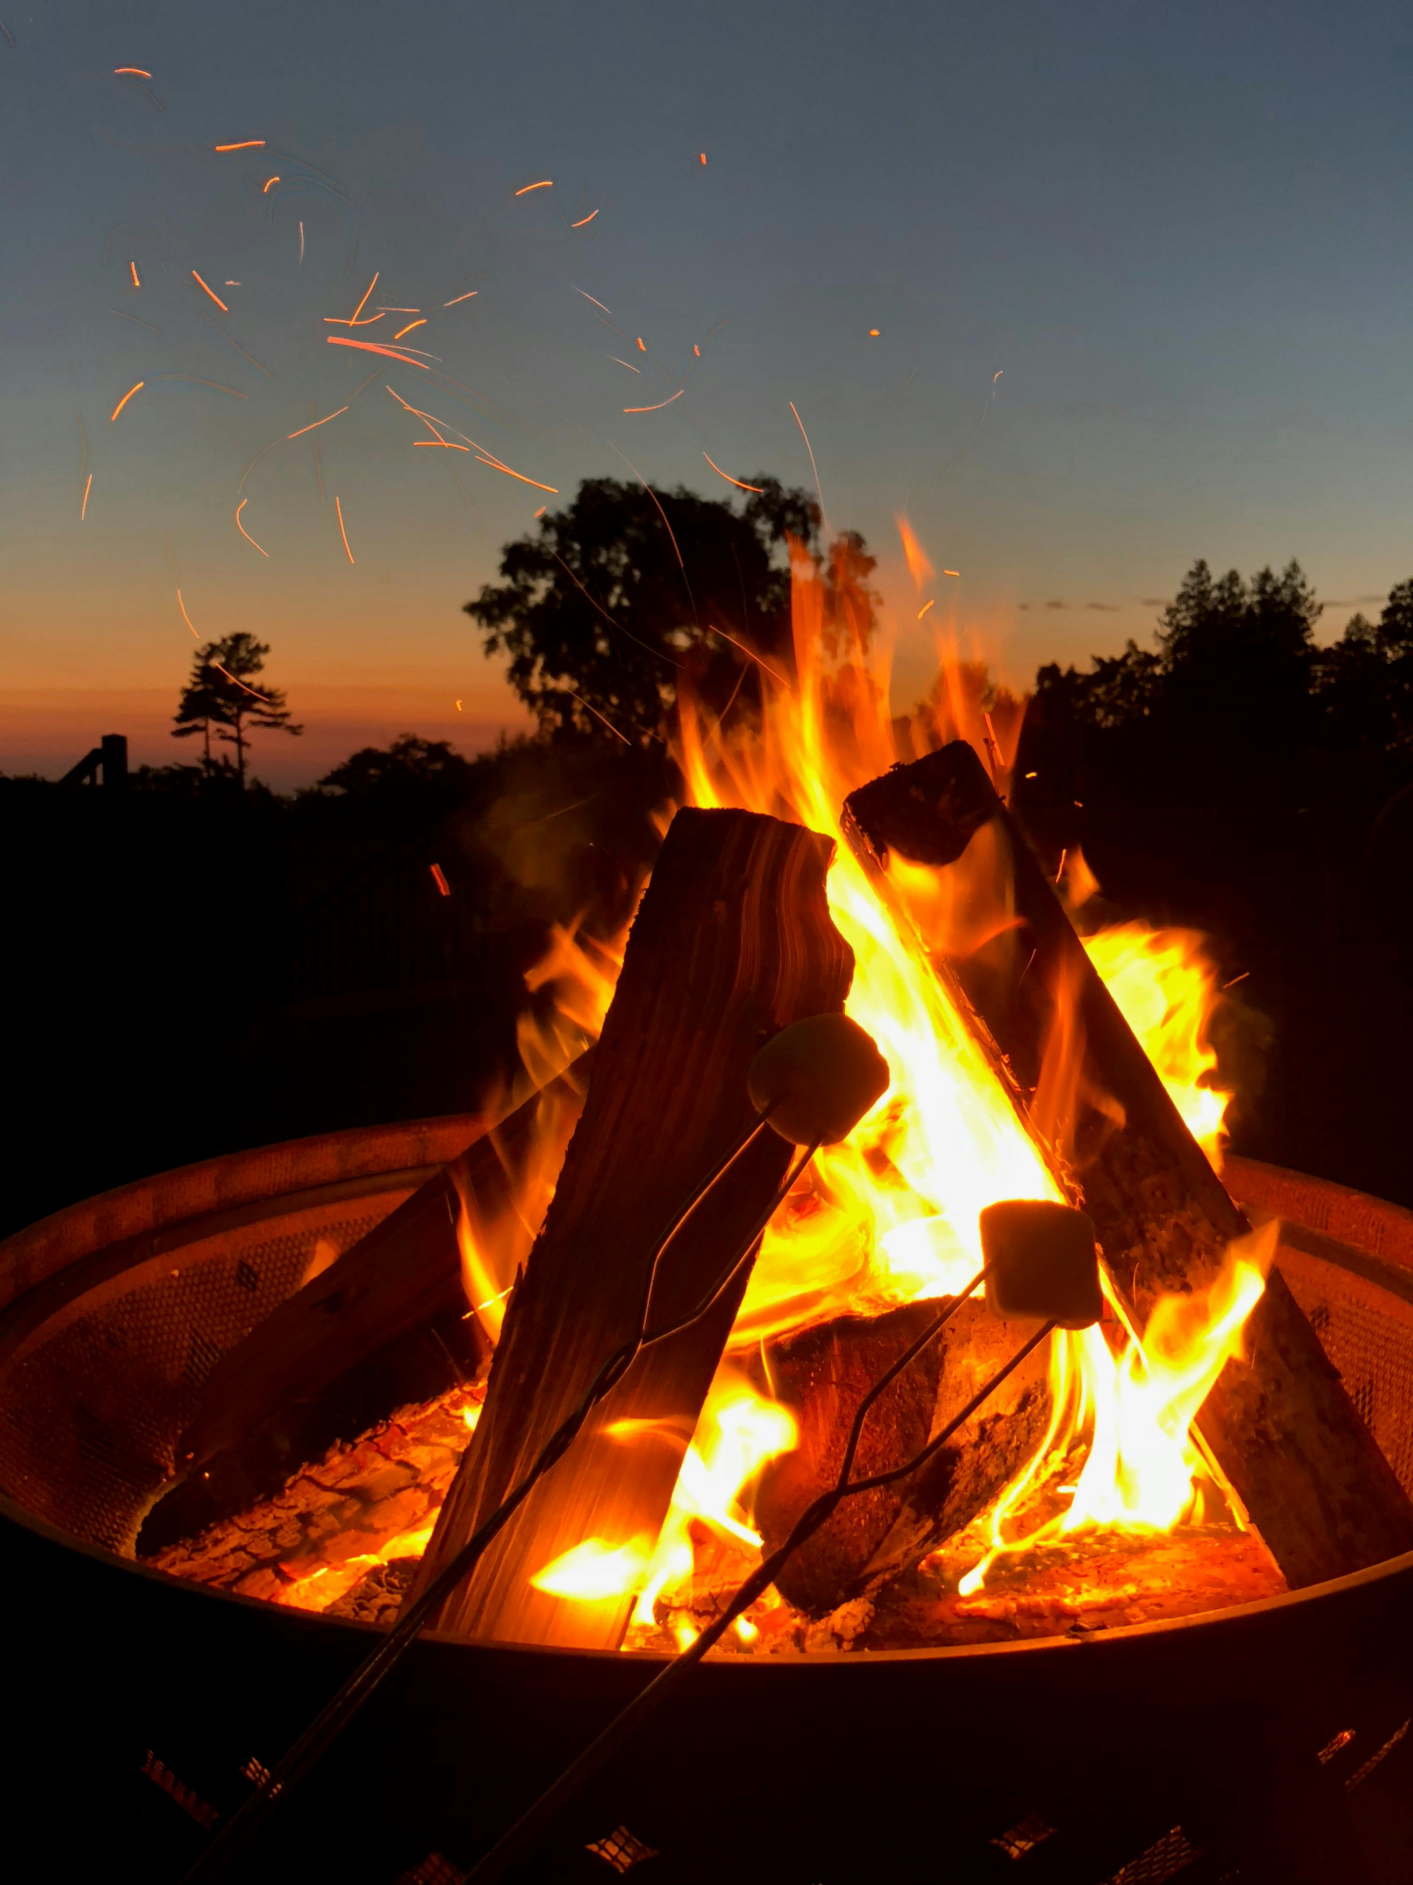





DT/ART
PE
English Autumn 2
In Design Technology we will be designing, making and evaluating a healthy salad for a special creature!
Art lessons will focus on exploring drawing and using different techniques such as continuous line drawing.
PE lessons will continue to be taken by Mrs Chadwick. This term the children will be focusing on fundamental skills. PE days will continue to be on a Monday.
During the second half of the term the children will be looking at non- fiction texts, exploring non -chronological reports, letters and linking our English to History and RE. We will also be making our writing more interesting by including adjectives and adverbs.
In addition, we will begin to look at how words are made up of consonants and vowels, helping us to begin looking at Y2 spelling rules. Punctuation such as exclamation marks, question marks and speech marks will also be looked at.
Geography/History
We will be exploring where we live and how we can look after our world.
Later in the term, our History topic will be the Gun Powder Plot.
Maths
This half term we will be revisiting numbers to 20 looking at how we make them, what is 1 more, 1 less of a given number, how numbers fit on a number line and ensuring we can write numbers correctly.
We will then progress onto looking at addition and subtraction. This will focus on number bonds to 10, 100 and developing strategies to add and subtract two- digit numbers.
Later in the term we will explore shape, including vocabulary such as vertices, edges and symmetry.
Throughout Autumn, we will tell the time using an analogue clock beginning with ‘O’ clock, half past and progressing onto quarter past and quarter to the hour.
As part of our computing work we will be getting familiar with some APPs linked to topic work and using Reading Eggs.
We will also be accessing websites to help us to research.
Computing
RE/PSHRE
In RE we will be looking at special books, including the Bible. Later in the year we will be exploring the good news of Jesus and celebrating Christmas. We will focus on special messages, how we share news and the special role of the angels in the Christmas story.
In PSHRE our topics are friendships, community, money and work.
Music
This term we will be using our voices to join in with call and respons games, experimenting with dynamics and exploring timbre with non- tuned percussion.

